Slide 1
District Court at 50
By Jim Drennan
2016

Slide 2
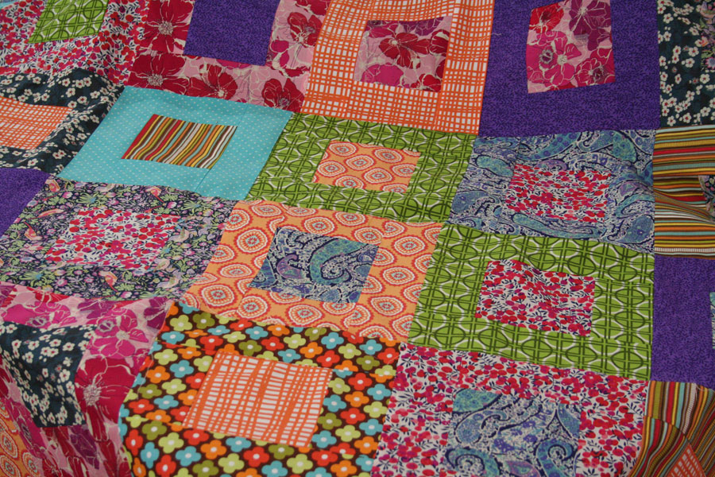

Slide 3
In 1970
In 2015-16
Notes:
1.1 Million filings in 1972
2400 jury trials
Traffic waiver rate of 69%
2.4 million filings in 2015.
127 jury trials
Waiver rate in the 30% range

Slide 4
Judicial Districts, 1960-2000
1960 – Thirty for all purposes
Six one-county districts, two seven-county
2015
District Court – 44 districts for elections
District Court – 41 for administration
15 one-county districts; two seven-county

Slide 5
Judicial Districts, 1960-2000
1960
Largest – 272,000 (Mecklenburg)
Smallest – 73,000 (1st, 6th, and 24th)
Ratio – 4/1
Average size – 151,871
2015 (estimated)
Largest – 1.034 million (26th), 1.024 million (10th)
Smallest – 62,000 (9A); 60,700 (20A)
Ratio – 17/1
Average size – 228,000

Slide 6
Judges Looked Different
Notes:
There were 112 judges on the bench. Three were females. Two were African-American. There were thirty judicial districts, the largest of which (Mecklenburg County) had seven judges. There were six districts that had only two.

Slide 7
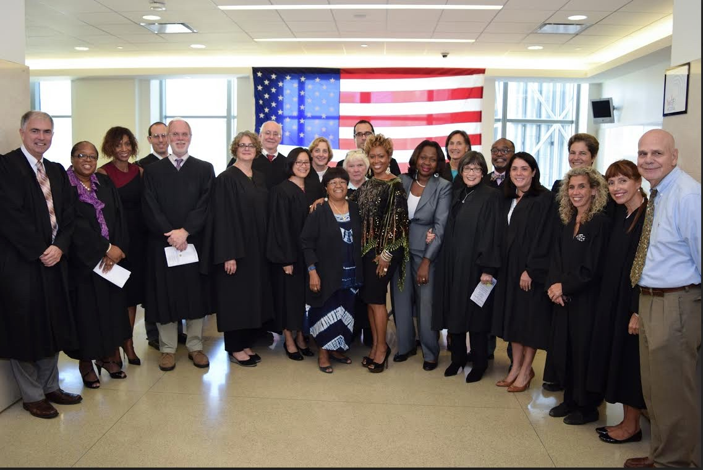
Notes:
54% WM
25% WF of the judges are white males
25% BF
7% BM
850 people served
26th had

Slide 8
So Do Court Users
Notes:
In 1970, there were just over 5 million NC residents, 74,000 of whom were of Hispanic origin.
Today, there are 270 judges currently serving the district court, in a state with over 10 million residents, 800,000 0f whom are of Hispanic origin.

Slide 10
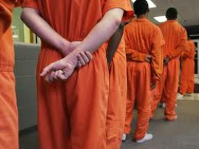
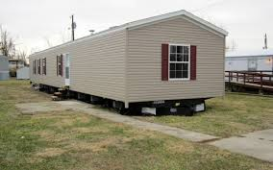
Society Changed
Notes:
Juvenile crime, school to prison pipeline.
Domestic Violence
Family breakup whether over a trailer or a mansion
Changing definition of family since Archie Bunker

Slide 11
So Did the Laws
50B
50-20
IV-D
50A
7B

Slide 12
And there was still crime (and traffic)
Discretion
1970 69%
2015 low 30’s
Class H and I
Notes:
That changed in 1996, when the General Assembly expanded district court jurisdiction to include the handling of guilty pleas in Class H and I felonies. While that seems to be a small change, class H and I felonies are 64 % of all felonies; 26% of all felony pleas to these offenses were taken in district court in 2013-14.

Slide 13
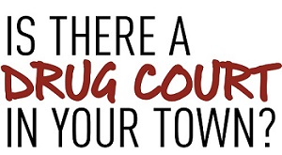
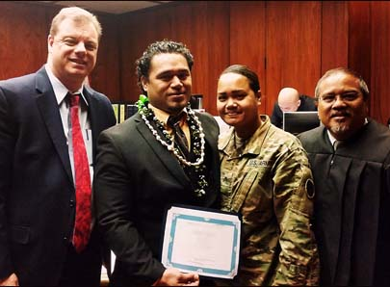
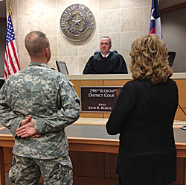
Courts, judge’s roles changed too
Notes:
King John meets Albert Einstein
Challenges for a system with 100 counties. Rolling out changes threatens any reform.
Drug court cut. TCA’s cut, family court perpetually on the block

Slide 14
The Fishbowl Gets Bigger

Slide 15
And Elections Are Never Far Away

Slide 16
Current Challenges
Technology support
Changing roles and norms for lawyers
23,100 and 6124
Access
Lawyers
Interpreters
Local funding and uniformity challenges
Jurisdiction
Programs
Maintaining judicial independence and public confidence
Notes:
In 2016, fourteen counties had employees funded by local governments. While the employees funded range from deputy clerks to administrative support staff to funds to pay retired judges, most of the funds are for assistant district attorneys and support staff in DA’s offices. Mecklenburg County courts are the single largest recipients. The District Attorney’s office in Mecklenburg County has funding from Mecklenburg County and the City of Charlotte for over 25 assistant prosecutors and a similar number of support positions. In 2015-16, the court system in Mecklenburg received over $3.2 million
District courts hearing felonies.
Problem-solving courts.
Family courts.
Local government providing funding for court employees.
Court costs funding local programs.
Local government funding, or obtaining grants for unique local programs for juvenile, criminal or domestic cases.

Slide 17
It’s in your hands.

Slide 18
It’s not really new
(39) No free man shall be seized or imprisoned, or stripped of his rights or possessions, or outlawed or exiled, or deprived of his standing in any way, nor will we proceed with force against him, or send others to do so, except by the lawful judgment of his equals or by the law of the land.
+ (40) To no one will we sell, to no one deny or delay right or justice.

Slide 19
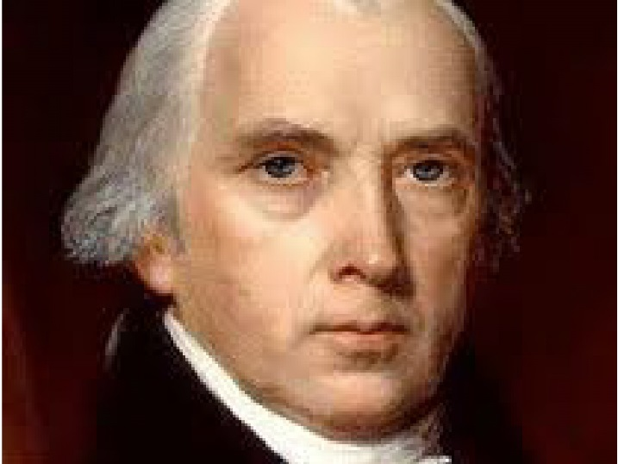
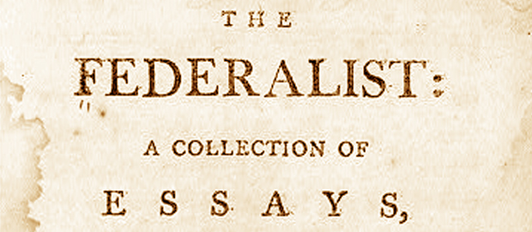
Or Ever Finished
Justice is the end of government. It is the end of civil society. It ever has been and ever will be pursued until it be obtained, or until liberty be lost in the pursuit.
No. 51
Notes:
This is one way to close the talk, by connecting the work of the courts with the work of the Founding Fathers, and either implicitly or explicitly, to the Magna Carta. The seeking of justice is a bedrock, foundational piece of a civil society. It is never finished, but the effort to promote a more just and fair society with the help of an effective court system will always be a major building block as we seek to create a “more perfect union”, as our Federal Constitution calls us to do.
Individual speakers will no doubt have other closing that are more appropriate to their particular talk.

Slide 20
Celebrate.NCcourts.org

